Slide 1
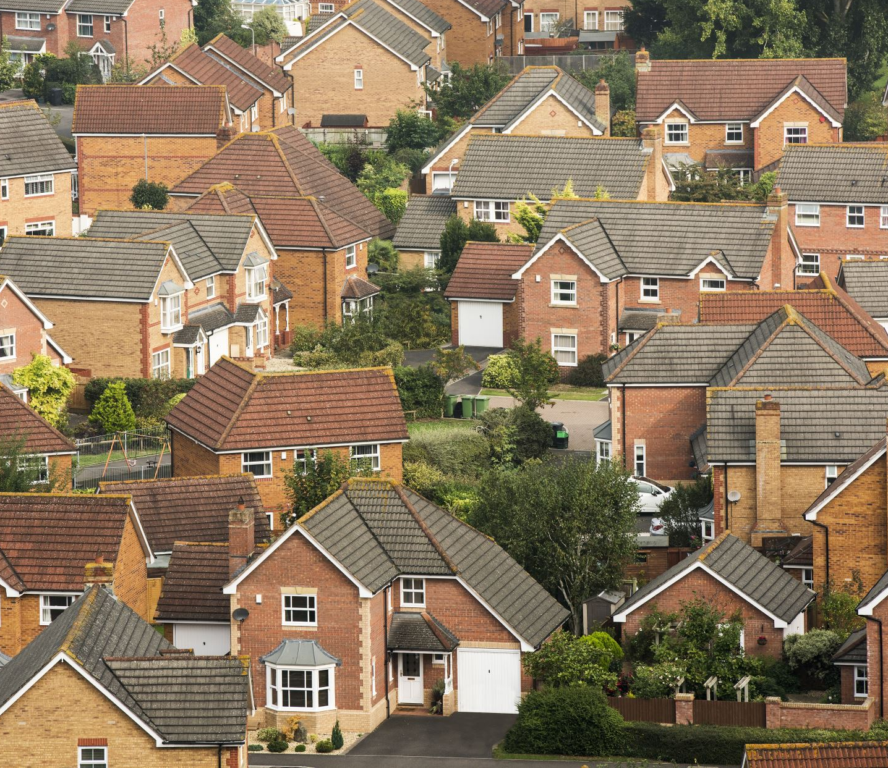
Housing Data Set ANALYSIS USING PYTHON
Pandidurai.N
DA $DS
MAY

Slide 2

Project Overview
Objective:
We studied a dataset about houses — like their prices, size, number of bedrooms, location, etc.
.The data contain (4600 rows and 18 columns)
Goal:
To understand what affects house price and find helpful patterns.

Slide 3
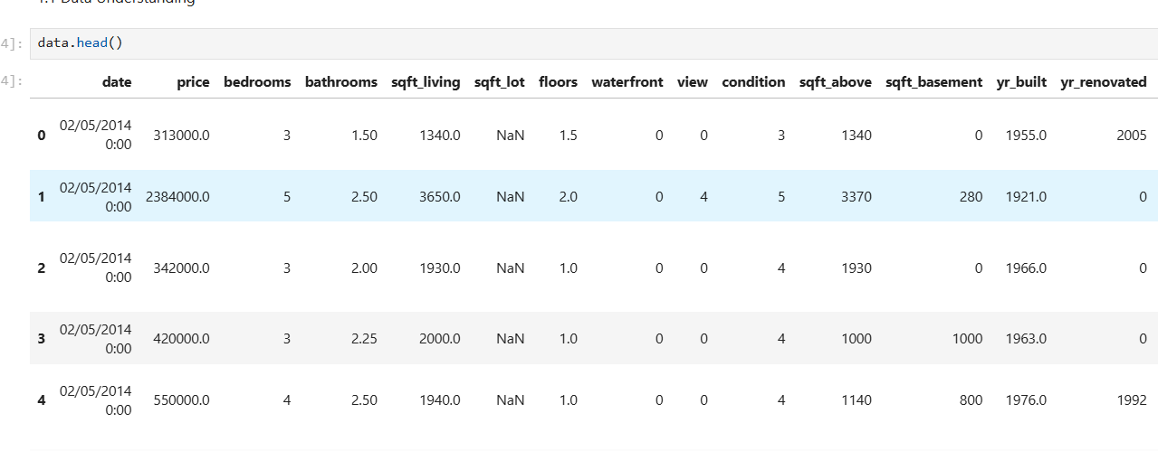
Data understanding
It contains details about many houses – their prices, size, location, and other features.
There are 18 columns giving different types of information for each house.
Types of data:
Numerical
Categorical
This data helps buyers, sellers, and real estate agents make smarter decisions about houses.

Slide 4
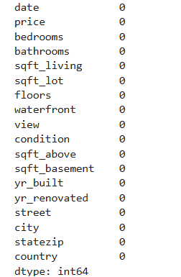
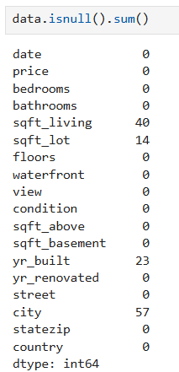
Data cleaning
Find the null values
Fixed or removed missing (blank) data
Remove the duplicates
Convert the (str) into (int) Eg:(price,bedrooms,etc,)
Remove time column (No data to analysis)

Slide 5
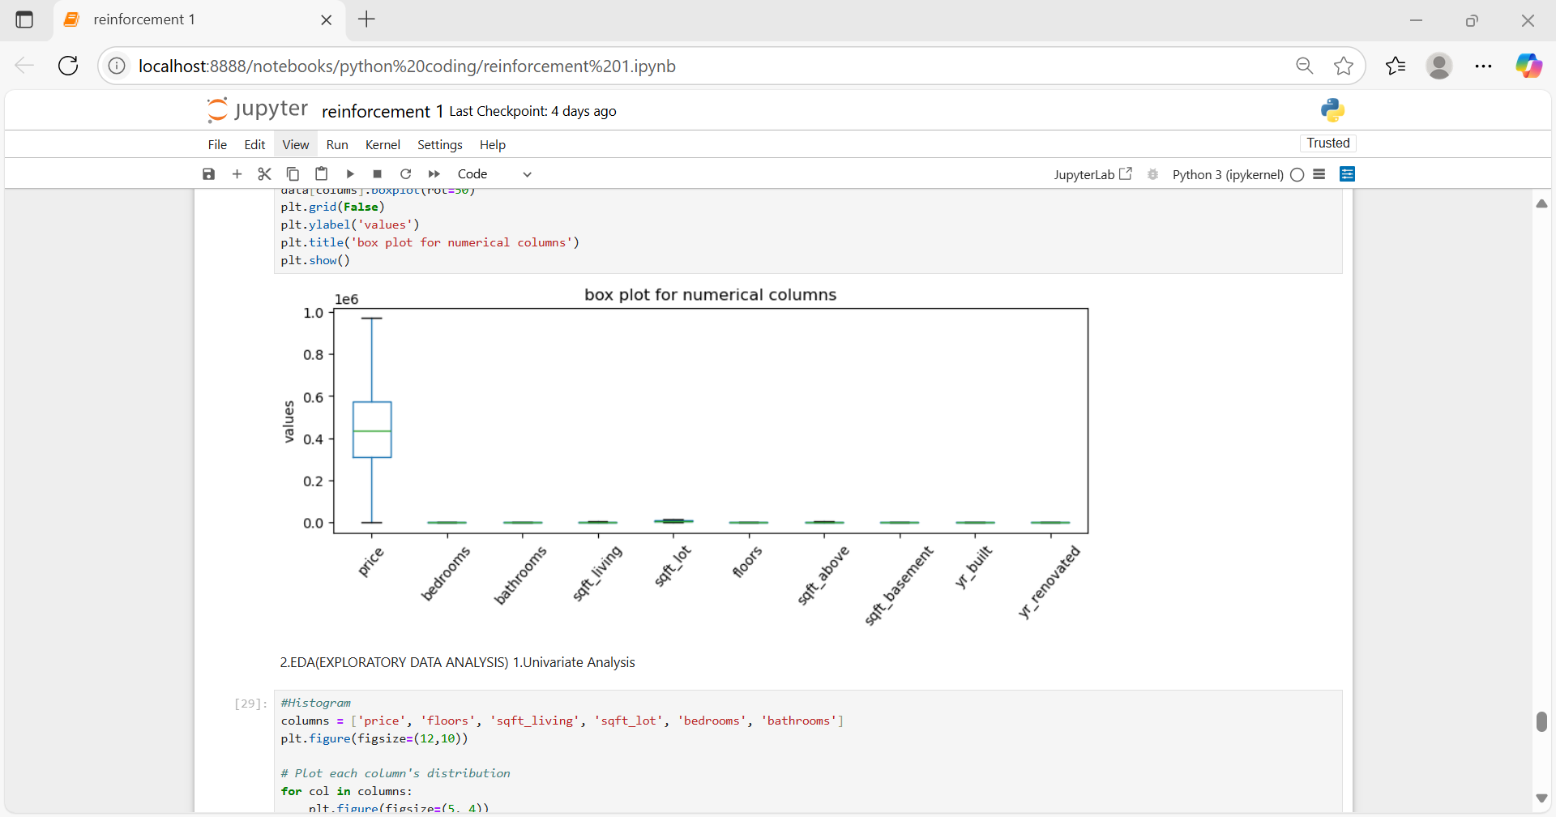
Outlier handling
Outliers are unusual values in the data — extremely high or low numbers that can affect results and predictions.
They distort averages
Can lead to poor model accuracy
May be errors or rare cases

Slide 6
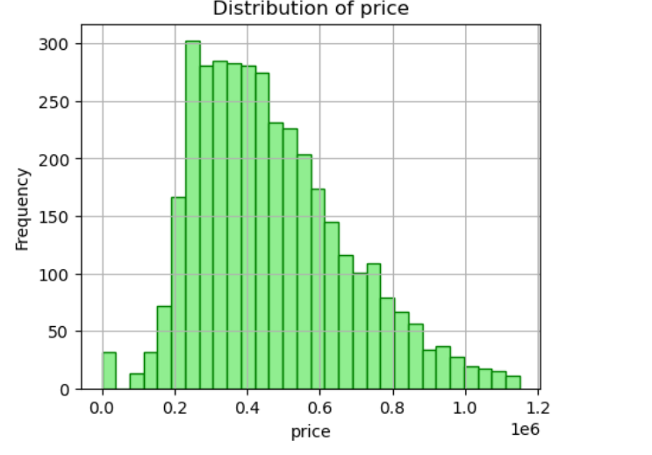
Exploratory data analysis (eda)
Univariate Analysis :
It’s the analysis of a single variable to understand its distribution, central tendency (mean, median), and spread (range, standard deviation).
Looked at one variable at a time (like price, size, bedrooms)

Slide 7
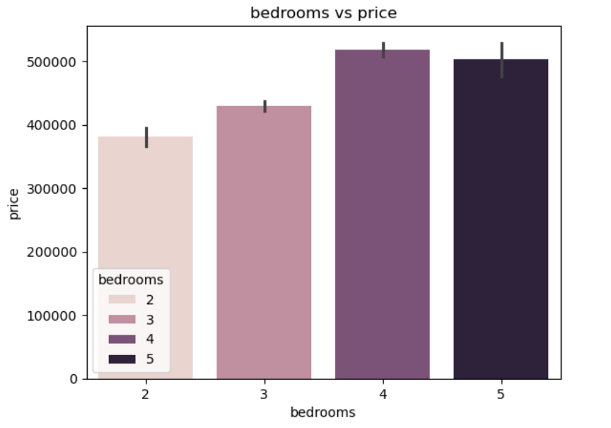
2.Bivariate Analysis:
comparing of two columns like .(price vs bedrooms)using Bar plot.
condition : price increase
Findings: Larger houses →The price will high

Slide 8
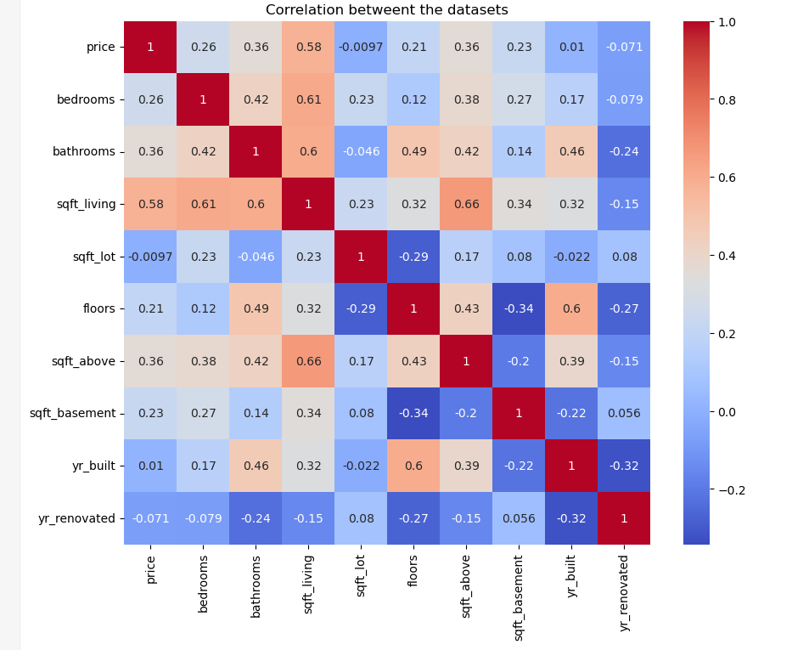
3. Multivariate Analysis:
Three or more variables related to each other –helps us find what features together affect house price the most.
Trends: Price varies by city and house size; top cities and premium home sizes command highest values

Slide 9

Data visualizations
Made graphs to see trends and patterns easily.
Bar plot to see how values are spread(price vs bedrooms)
Scatter plots to see relationships (like price vs bedrooms)

Slide 10

conclusion
Key Insights
Bigger houses usually cost more
Location and view matter a lot in price
Suggestions
For buyers: Focus on size, location, and condition
For sellers: Renovate or improve condition to raise price
For investors: Properties with good views or in popular cities are better investments

Slide 11

Thank you

